Slide 1
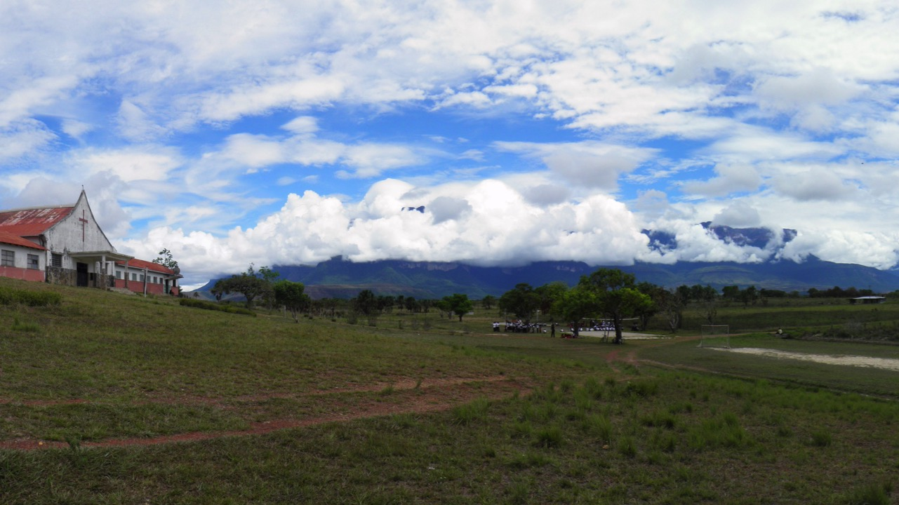
+
Jimmie Angel Historical Project
Activities report 2017: Kamarata Valley, Canaima National Park - Venezuela
Marianela Camacho Fuenmayor
March, 2017

Slide 2
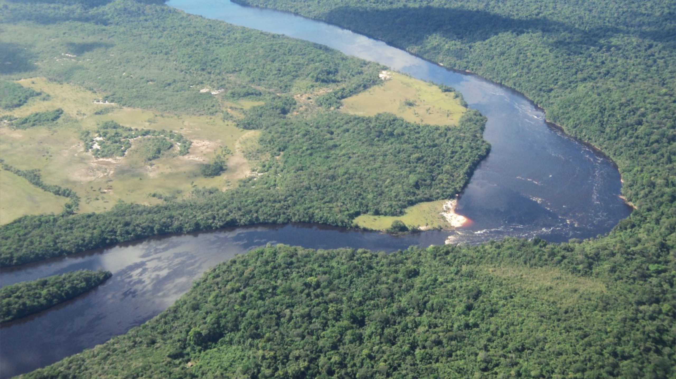
INDEX
Cultural Centre
Agroproductive Centre
First digital maps and Geographical Information System (GIS) of Kamarata Valley
Playground project

Slide 3
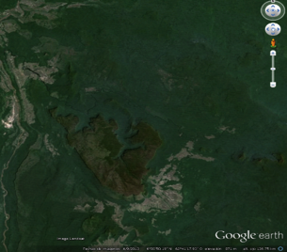
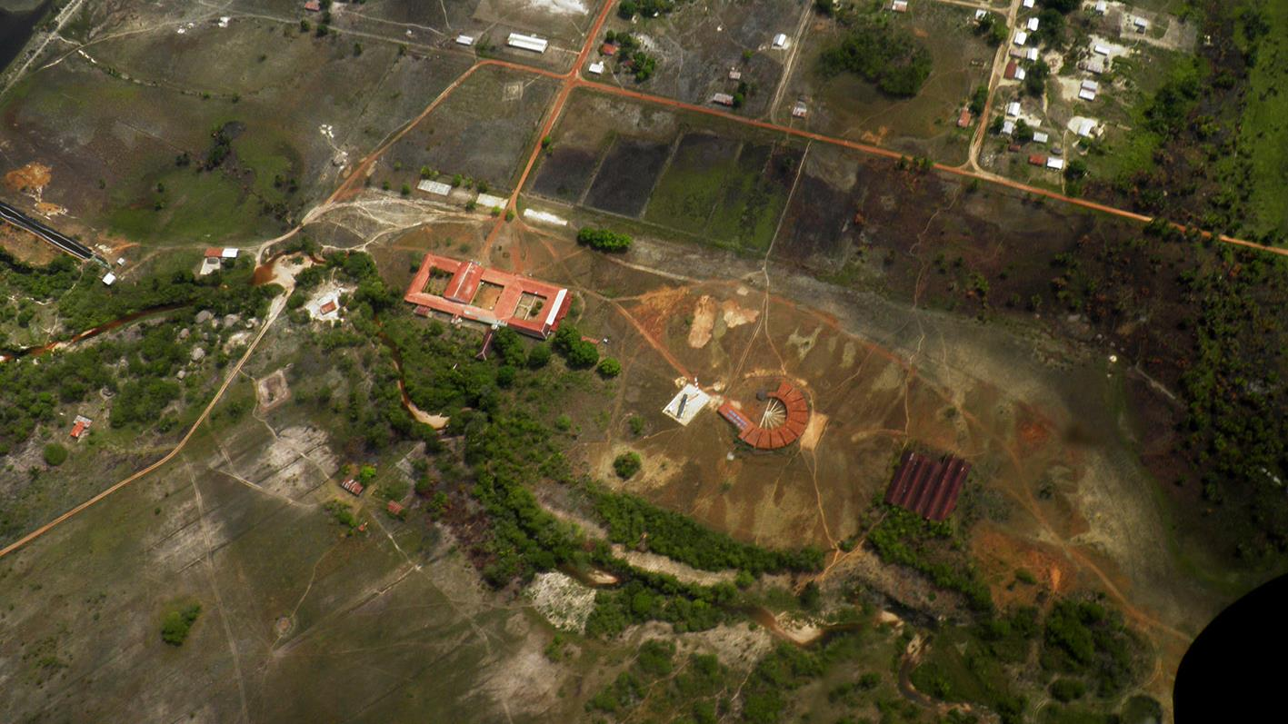
1. CULTURAL CENTRE
Laguna de Canaima
Salto Ángel
AUYANTEPUY
Kavak
Kamarata
Uruyén
Missionary Centre of Kamarata
Cultural Centre
Agroproductive Centre

Slide 4
1. CULTURAL CENTRE
Grant
Cultural Centre of Kamarata: Autonomous and autochthonous expressions, related to the natural, daily and artistic world of the Pemón Kamarakoto ethnic group
Currently this project is led by the Captain of Sector II Kamarata - Kanaimö, the Communal Council of Kamarata, Fundación Etnika and Universidad del Zulia.
At the end of 2016, the Small Grants Program (PPD) of the Global Environment Facility (GEF) of the United Nations Development Program in Venezuela (UNDP - Venezuela) approved a grant for this project, to cover two fundamental phases: one of training and one of physical intervention.
The objective is to repair and utilize some buildings that are not being used in the community, they are a part of the Missionary Centre of Nuestra Señora de Coromoto in Kamarata. In turn creating the first Cultural Centre for the indigenous communities that inhabit Kamarata Valley, Canaima National Park, Venezuela.

Slide 5
1. CULTURAL CENTRE
Project‘s purpose
The objective is provide meeting spaces with the aim to enhance relations between members of different communities of Kamarata's valley, develop and strengthen their capacities to participate actively in the collective search of alternatives to solve immediate needs, at the same time satisfy the needs of education in “values” targeting the younger population of the community and help educate against such illegal activities as mining.
It is not a matter of “fossilizing” the culture of the place, it is about using its dynamics to promote the meeting between the members of the communities in other spaces, different from those of work and daily life; because leisure and recreation activities contribute to fostering new dynamics, new meeting spaces for human and cultural relations.
The objective of the initial phase - develop participatory workshops to consolidate the physical intervention proposal to “recycle” the building and generate a management structure of the cultural space.
The physical intervention phase - cleaning the buildings, painting, and primarily fix the roof of the infocentro space and services areas.

Slide 6
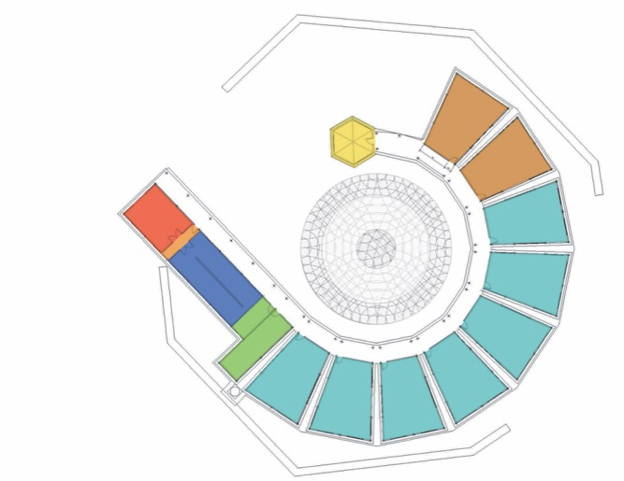
1. CULTURAL CENTRE
Proposal for use the spaces of the current buildings
Space for permanent exhibition
2 Multipurpose rooms
The walls can be folded and the space unified
Gallery space for traveling exhibitions
Office/Meeting room
7 Workshop classrooms
Art
Painting
Dance
Textile
Woodwork
Jewelry
Education for work
Service area
Solar batteries
Square/ Amphitheatre
Computer room/Infocentro
Storage and bathrooms
Total area - 1300m²

Slide 7
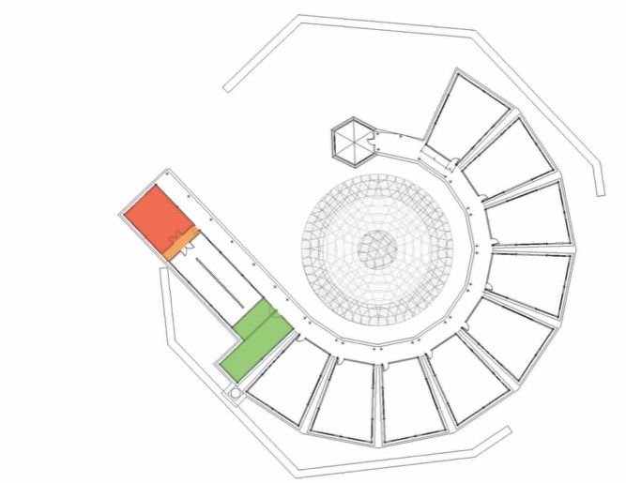
1. CULTURAL CENTRE
Proposal through PNUD project
Space for permanent exhibition
Gallery space for traveling exhibitions
Office/Meeting room
Service area
Solar batteries
Square/ Amphitheatre
Computer room/Infocentro
Storage and bathrooms
Total area first intervention - 600m²

Slide 8
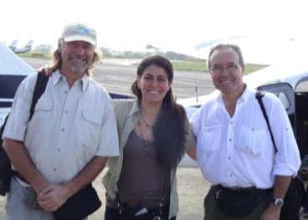
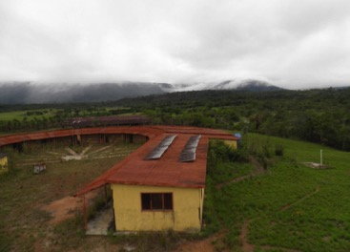
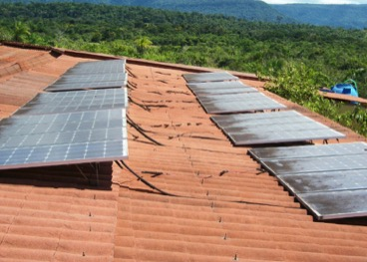
1. CULTURAL CENTRE
Visit to Kamarata, March 2017
In March 2017, Paul Stanley, Morel Orta and Marianela Camacho traveled to the community of Kamarata in order to organize meetings with the leaders of the project in the community, establish strategies for working as a team, as well as to make an evaluation of the buildings and especially the solar panels / alternative energy system available in the building. In order to prepare and condition the building for its cultural use implies an operative system that can deliver and supply “clean” energy.
A significant contribution to this visit was the birth of a cultural group of young people from the community, who lead the activities for the creation of the activities program relevant for the community. Naturally with the support of the Kamarata communal captaincy.
Paul Stanley, Marianela Camacho and Morel Orta.
PHOTO: Paul Stanley, 2017.
Solar panels system in the building for the Cultural Centre.
PHOTO: Emilia Calcaño, 2017.
Solar panels system in the building for the Cultural Centre.
PHOTO: Emilia Calcaño, 2017.

Slide 9
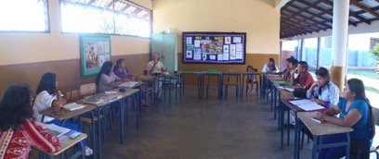
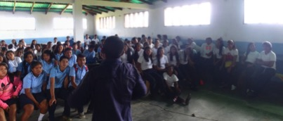
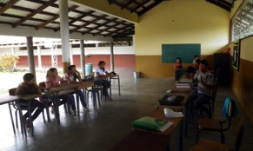
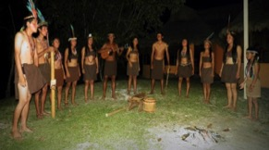
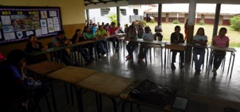
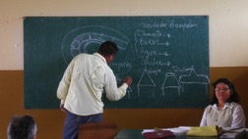
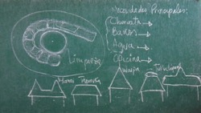
1. CULTURAL CENTRE
Visit to Kamarata, March 2017
The project was presented by community leaders (Captain of Kamarata community), Communal Council of Kamarata and Fundacíon Etnika to the teachers of the different schools, to the young people of the high school, parents and representatives, as well as a special session with the youth cultural group of the community.
Workshop with teachers of primary school.
PHOTO: Marianela Camacho, 2017.
Workshop with the high school students in charge of the Kamarata Community Captain Abrahan Sandoval.
PHOTO: Marianela Camacho, 2017.
Workshop with the cultural group of Kamarata.
PHOTO: Marianela Camacho, 2017.
Workshop with the parents, representatives and general community in charge of the Captain of the Community of Kamarata Abrahan Sandoval.
PHOTO: Marianela Camacho, 2017.
Cultural performance of the cultural group of Kamarata.
PHOTO: Marianela Camacho, 2017.

Slide 10
2. AGROPRODUCTIVE CENTRE
Laguna de Canaima
Salto Ángel
AUYANTEPUY
Kavak
Kamarata
Uruyén
Missionary Centre of Kamarata
Cultural Centre
Agroproductive Centre

Slide 11
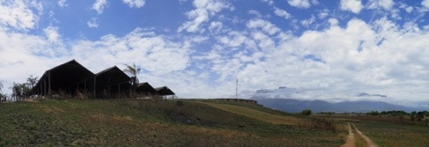
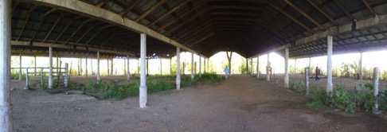
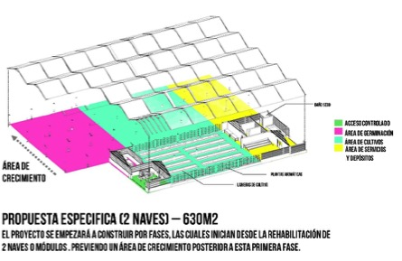
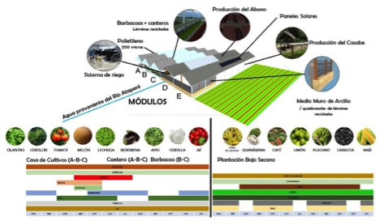
2. AGROPRODUCTIVE CENTRE
Purpose
Recycle the structure of a set of sheds as a cultivation centre to promote the creation of a Sustainable Agro-productive Centre for the indigenous community of Kamarata.
Building belonging to the Missionary Centre of Kamarata for the cultivation centre.
PHOTO: Marianela Camacho, 2017.
Building of the Missionary Centre of Kamarata for the cultivation centre.
PHOTO: Marianela Camacho, 2017.
Cultivation Centre project. By: Ing. Agr. Fátima Urdaneta, Arq. Marianela Camacho, Ing. Agr. César Chirinos, Arq. Argenis Toyo, Arq. Frederick Acurero

Slide 12
2. AGROPRODUCTIVE CENTRE
Grant
In 2016 the Alstom Foundation through Eposak approved financing to implement the first phase of the productive project through two phases, one of training and the other of physical intervention to the sheds, led by the indigenous community of Kamarata and the University of Zulia.
During the year 2017, the training and construction phase of the first demonstration plot began, thus beginning the cultivation of vegetables.
Subsequently, the community leaders of this project organized the construction of allotments for growing vegetables with the parents and children who attend the National Basic School Padre Eulogio de Villarrín.

Slide 13
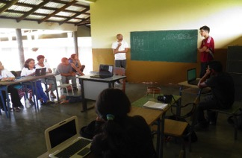
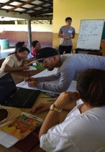
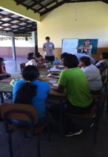
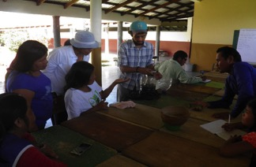
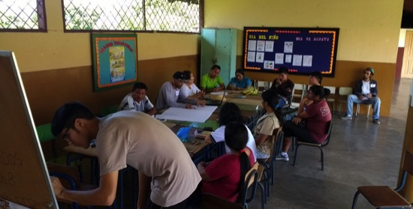
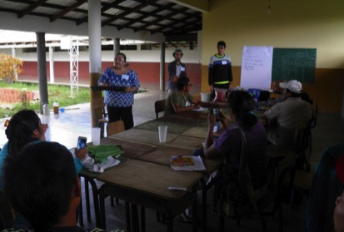
2. AGROPRODUCTIVE CENTRE
Workshops and training - August 2017
Workshops and training by teachers and ex-students of Universidad del Zulia.
PHOTOS: Marianela Camacho, 2017.

Slide 14
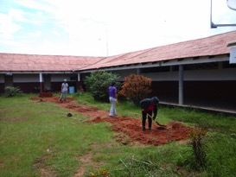
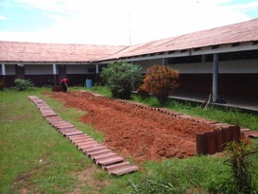
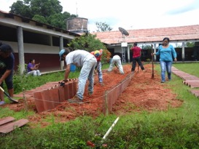
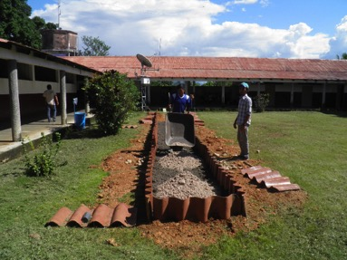
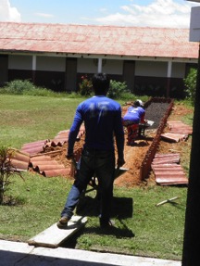
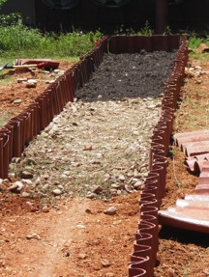
2. AGROPRODUCTIVE CENTRE
Workshops and training - August 2017
Construction of the first allotment for growing vegetables.
PHOTOS: Marianela Camacho, 2017.

Slide 15
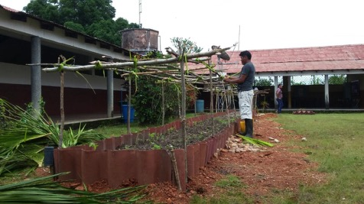
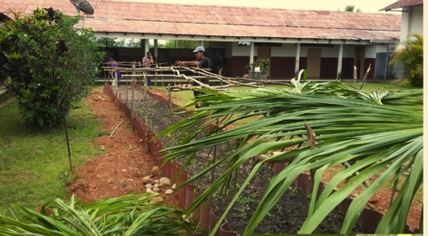
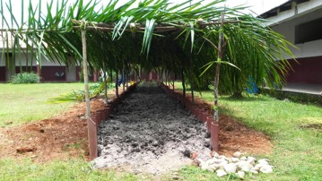
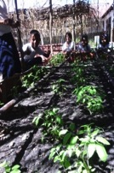
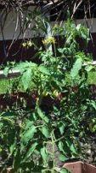
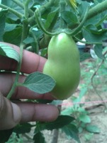
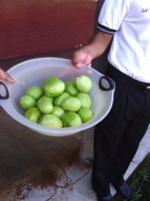
2. CENTRO AGROPRODUCTIVO
Workshops and training - August 2017
Construction of the first allotment for growing vegetables.
PHOTOS: Indigenous community of Kamarata, 2017.

Slide 16
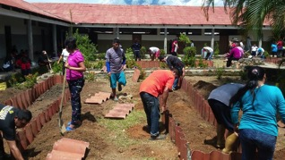
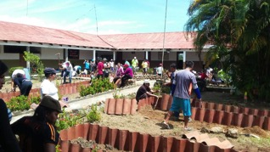
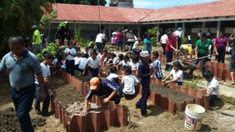
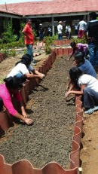
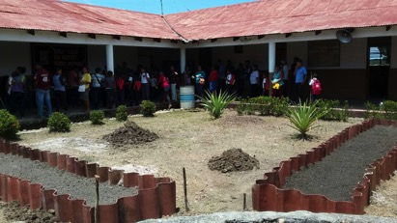
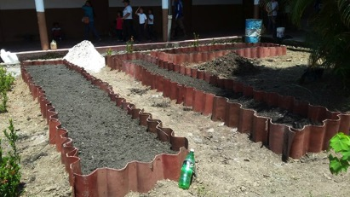
2. CENTRO AGROPRODUCTIVO
Building spaces for cultivation
Construction of the allotments for growing vegetables with parents and children of the scholar community of the Basic National School Padre Eulogio de Villarrín.
PHOTOS: Indigenous community of Kamarata, 2017.

Slide 17
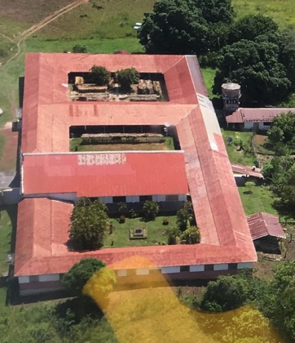
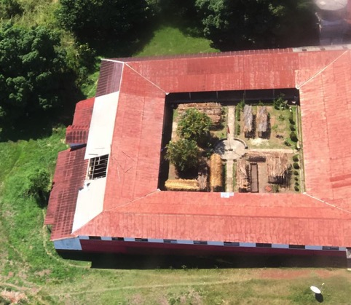
2. CENTRO AGROPRODUCTIVO
Contstruction of allotments for growing vegetables
Aerial view of the Missionary Centre Nuestra Señora de Coromoto at Kamarata community where we can observe the allotments for growing vegetables in its gardens.
FOTOS: Padre Xavier Serra, 2017.

Slide 18
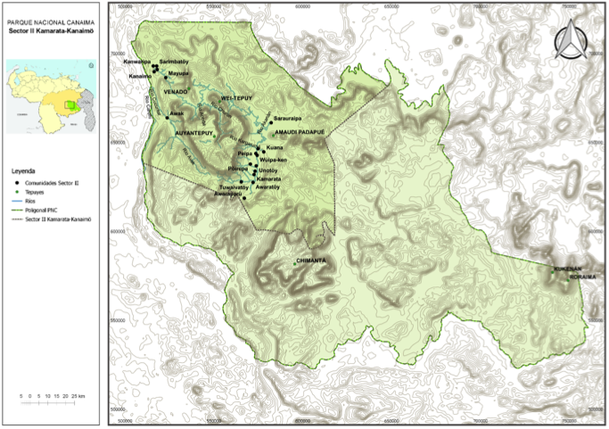
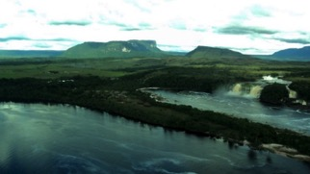
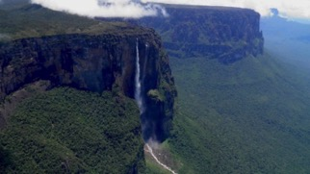
3. DIGITAL MAP AND GIS
Canaima National Park
The digital maps and the Geographical Information System (GIS) of Kamarata Valley are results of the doctoral thesis Participatory cartography and local sustainable development proposals to the indigenous communities at the Kamarata Valley. Canaima National Park – Venezuela. Universitat Rovira i Virgili. Marianela Camacho, 2017.

Slide 19
3. DIGITAL MAP AND GIS
Kamarata Valley communities
The digital maps and the Geographical Information System (GIS) of Kamarata Valley are results of the doctoral thesis Participatory cartography and local sustainable development proposals to the indigenous communities at the Kamarata Valley. Canaima National Park – Venezuela. Universitat Rovira i Virgili. Marianela Camacho, 2017.

Slide 20
3. DIGITAL MAP AND GIS
Indigenous community of Kamarata
The digital maps and the Geographical Information System (GIS) of Kamarata Valley are results of the doctoral thesis Participatory cartography and local sustainable development proposals to the indigenous communities at the Kamarata Valley. Canaima National Park – Venezuela. Universitat Rovira i Virgili. Marianela Camacho, 2017.

Slide 21
4. PLAYGROUND PROJECT
The purpose
Provide tools to the community to participate in building a landscape design of a playground for children of Kamarata’s community deploying sustainable principles.
PHOTOS: Marianela Camacho, 2017.

Slide 22
4. PLAYGROUND PROJECT
Ideas from students of the University of Zulia
Proposal 1
Kristina Sulbarán y Andrés Terán. November 2016.

Slide 23
4. PLAYGROUND PROJECT
Ideas from students of the University of Zulia
Proposal 2
Alejandra Chávez. November, 2016.
.

Slide 24
4. PLAYGROUND PROJECT
Ideas from students of the University of Zulia
Proposal 3
Vanesa Borges. November, 2016.
.

Slide 25
4. PLAYGROUND PROJECT
Ideas from students of the University of Zulia
Proposal 4
Mary Carmen Moreno y José C. Bermúdez. February, 2017.

Slide 26
4. PLAYGROUND PROJECT
Ideas from students of the University of Zulia
Proposal 5
Joselys Medina. February 2017.

Slide 27
4. PLAYGROUND PROJECT
Ideas from students of the University of Zulia
Proposal 6
María Paola González Cohen. November, 2016.

